Slide 1
Computer science: algorithms
By Andrei rusu

Slide 2
Contents
Movement in maze
Pathfinding Algorithms
Dijkstra’s Algorithms
A* Algorithm
Comparison and best choice
Storing Candy
Sorting Candy

Slide 3
Movement in maze
By moving a larger amount of cells the maze will result more walls than empty areas.
When maze movement tis not constant we can conclude either of the following:
Increase in walls compared to empty space
Increase in empty spaces compared to walls
Maze resulting in no walls, thus any path counts as a solve.

Slide 4
Pathfinding algorithms
In the following slides we shall be discussing and comparing 2 pathfinding algorithms and conclude which one is best to use taking into consideration of our project.

Slide 5
Dijkstra's algorithm
In summary the algorithm computes the shortest distance from a given point vertex to all the vertices in the graph.
The algorithms uses a distances HashMap where start vertex is initialized to 0 while others are set to infinity. From the start we pop of the start and check its neighbors and update the distances hashmap. Once all neighbors of start are visited we pop of the minimum distance vertex and check its neighbors, and continue until all vertices have been popped off and our hashmap now contains the shortest distances from start to all its vertices.

Slide 6
A* algorithm
In summary A* is an modification of Dijkstra's algorithm. A* also implements heuristic values which are estimates distance from start vertex to goal vertex.
In addition to the Distances HashMap , we also have H-Distances(made out of vertex distance + heuristic value).
For this algorithm we pop off the minimum distance off the H-distances(in a similar fashion to Dijkstras) and vertex neighbors are checked and H-distances updated. Using heuristics we optimize the algorithm at every single move in order to improve the efficiency in finding the goal.

Slide 7
Best choice of pathfinding algorithm
In our project we know the start start point and the end point ,as a result heuristics can be applied. In this case the optimal solution would include A* implemented in the finding the path most optimally.
Using Dijkstra’s would be preferred if we did not know the end point, as a result Dijkras would look at every path and find the shortest.

Slide 8
Storing candy
In the most optimal case we would use a hashmap, with the key being the candy type/name and the value with the number of candy picked up. A python dictionary can be implemented as the hashmap.
HashMaps provide us with constant (O(1)) time complexity when retrieving the data.

Slide 9

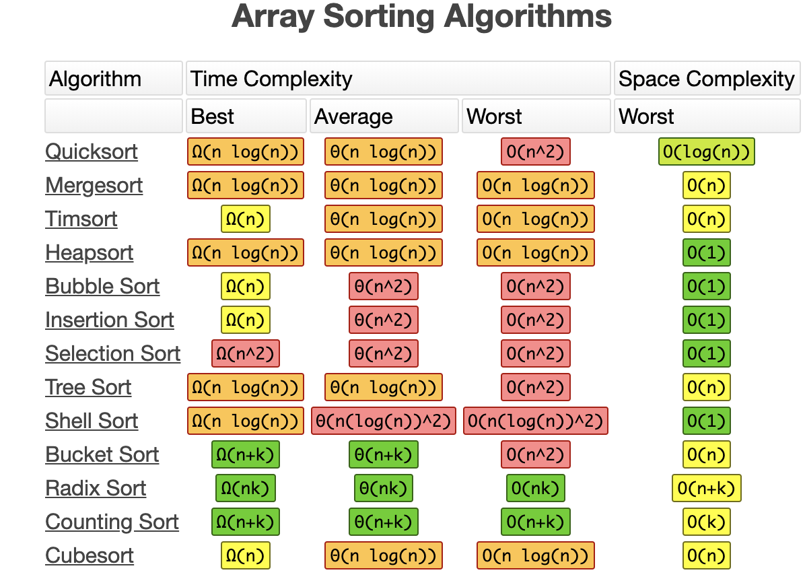
Sorting candy
Looking at the Time Complexity of common list sorting algorithms, the best are shown within the purple box border.

